Slide 1
Introduction to package managers
1

Slide 2
What is a package manager?
A package manager is a tool or command line utility, that manages your software or “packages”
2

Slide 3
Introduction to package managers via the Command Line Interface (CLI) lab
3

Slide 4

Step 1. Lab setup
On your desktop, there should be an application called VMware workstation pro
The icon should look like this
4

Slide 5
Step 1. Lab setup cont.
Your next objective after opening up the application, you should boot up the Virtual Machine (VM) labeled “Intro to package managers”, and start it. If you need help, raise your hand!
5

Slide 6
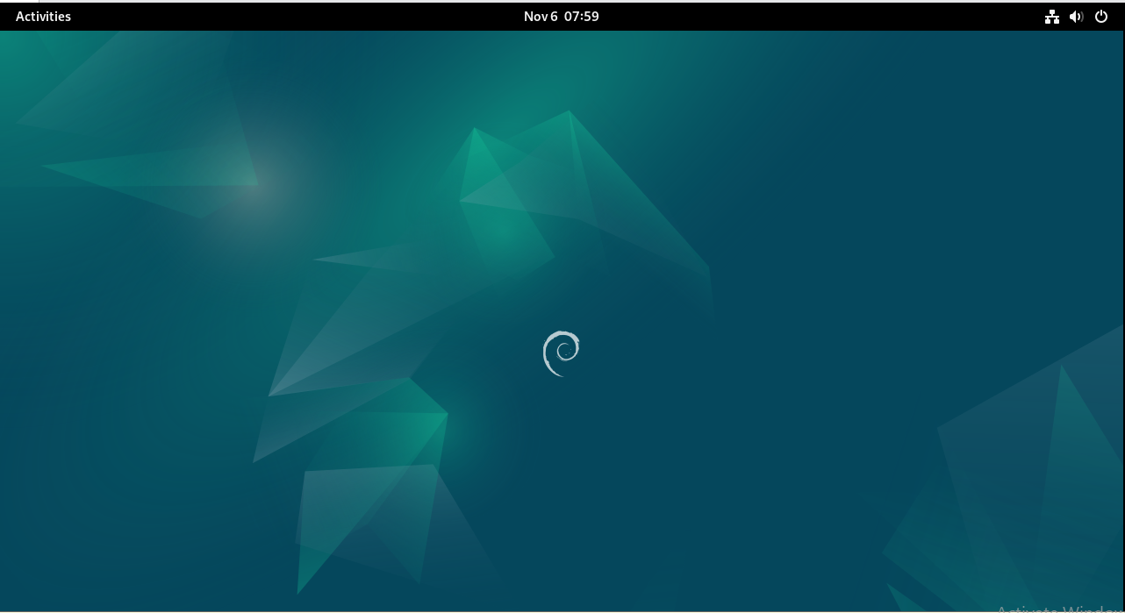
Step 2. Open Terminal
Now that you have booted into Debian linux, you should click the activities button in the top left button of the screen.
6

Slide 7
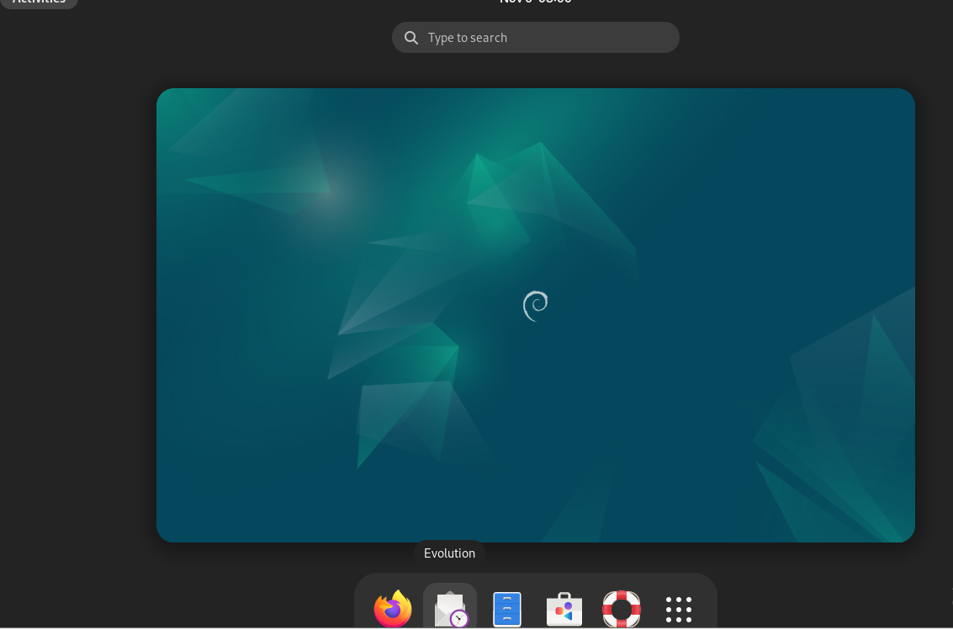
Step 2. Open Terminal cont.
Now you should see a waffle button, as well as any pinned applications, click the waffle button.
7

Slide 8
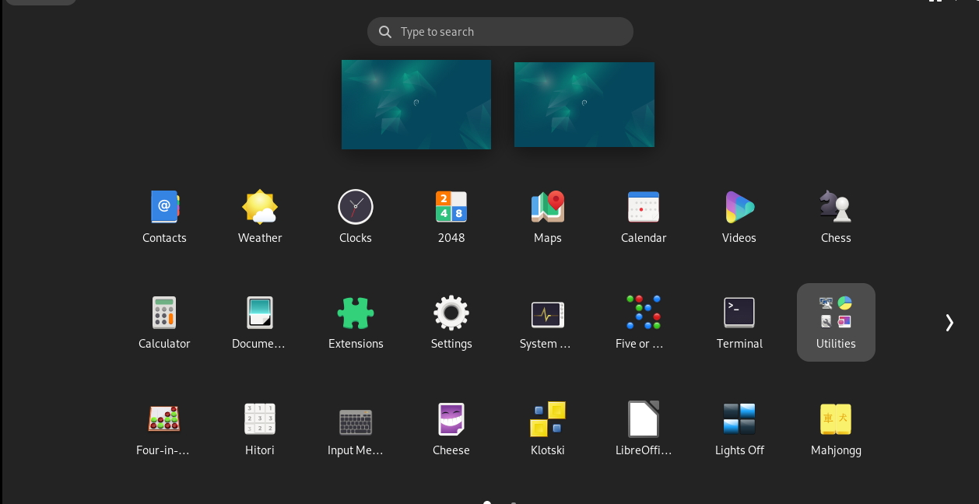
Step 2. Open Terminal cont.
Now find the terminal application in the application list, and open it.
8

Slide 9
Step 3. Install firefox
Run the command sudo apt install firefox
the password is `Cyber_Patriot!`
type y when prompted
9

Slide 10
TIP: “Package” names are case sensitive
Congrats! You installed your first package
TIP: Think of a package manager like Amazon; you order something, and then receive a “package” from them.
10

Slide 11
Step 4. Install rkhunter
On your own
Use apt install syntax to install a package named rkhunter
11

Slide 12
Step 5. update rkhunter db
run `sudo rkhunter --update`
12

Slide 13
Final Step. Run rkhunter
Run `sudo rkhunter -c`
13

Slide 14
Any Questions?
14

